Slide 1
Intro to Android Programming Getting Started
Chris Bursk
David Jones
Ellery Chan
And Others

Slide 2
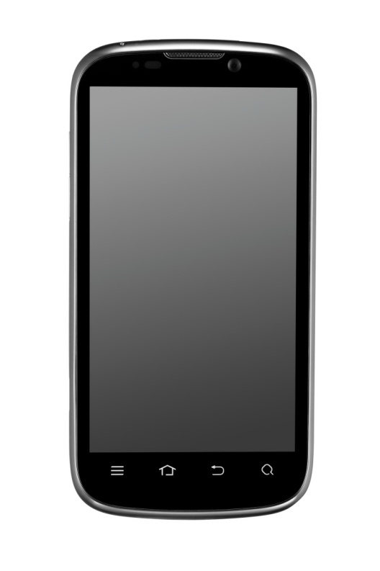


The Mission
+
+
Smart
Phone
Your Team
=
Crime Fighting Technology!!
Notes:
“You have already been briefed on the Harris Design Challenge.”
Your team will use a Smart Phone running the Android OS.
You will write one or more Android Apps that you will use
to stop the Evil Mastermind, Dr. Aardvark,
and save the world.

Slide 3
Course Outline
Getting started
Android overview
Android Development tools
Android Application Project structure
Lab - Hello World

Slide 4
Course Outline
Part 1
What is Android?
Android Development Tools
Part 2
Android User Interface
Android Events and Callbacks
Your First Android App
Better, Smarter Apps
?
Notes:
This Android tutorial will be divided into two parts.
In the First Part, we will get acquainted with the main parts of the Android environment,
and the development tools that we will use to build Android apps.
We will make sure all of your tools are working correctly, and we will create a very simple
“Hello, World” Android app, and run it.
In the Second Part, we will explore some of the details of the Android user interface, and
extend our app to incorporate a variety of user interface elements,
such as buttons, text, checkboxes, and text entry fields.
We will also learn more about receiving events from the Android system
and writing callbacks to handle those events.
We are going to go through this material pretty fast, so please follow along closely.
You will have plenty of time to experiment later.
Comments on Procedure:
We will try to call things by their correct names. In fairy tales, if you know the real
name of something you have power over it (Rumplestiltskin). That is true here also.
If you know the name of something, then you can Google it.
If you do get stuck on something, let one of us know. We have several helpers who
can help get you back on track.
If you have questions at any time, feel free to ask. Others are probably wondering the same thing.
You might be able to stump us. It’s probably not too hard. We may not know all the answers immediately.
But we are pretty good at finding them or figuring them out eventually.

Slide 5
Android Overview
Android is software for mobile devices that includes an operating system and key applications
The Android SDK provides the tools and Application Programming Interface (API)s necessary to begin developing applications
Reference - Android Developers
NOTE – Hyperlinks to online documentation are embedded in this presentation for quick reference

Slide 6

What is Android?
?
Notes:
So what is Android?

Slide 7


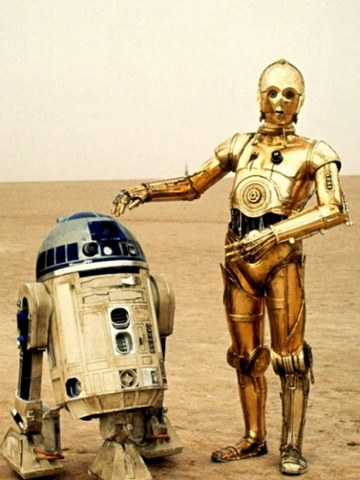

What is Android?
Notes:
Are we programming one of these?
No.
Does anybody here have an Android phone,
Or tablet (Samsung, Kindle, Nexus, …)?

Slide 8
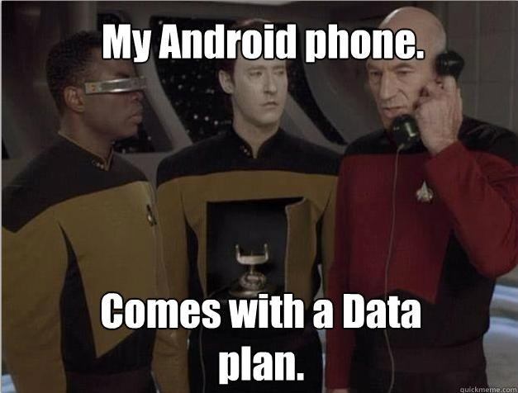
What is Android?
Notes:
How about this Android phone?

Slide 9
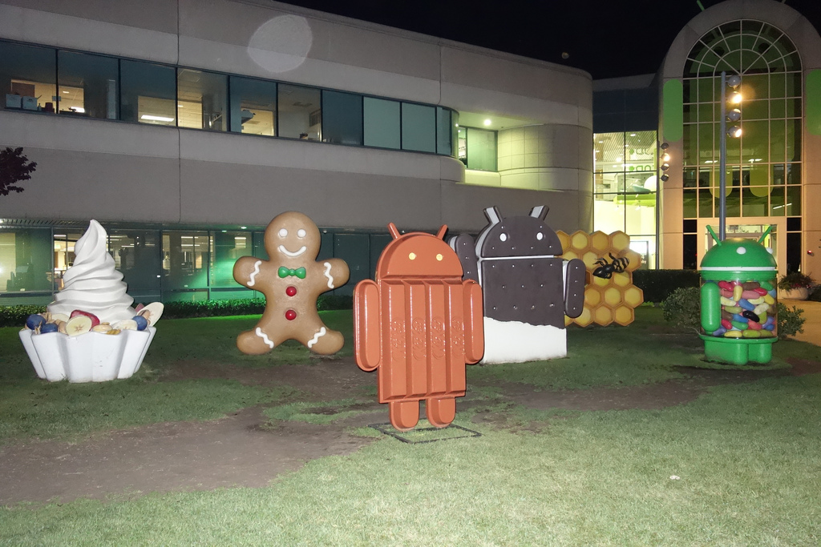
What is Android?
Versions not shown:
1.5 Cupcake
1.6 Donut
2.1 Éclair
5.0 Lollipop
ver 3.2
Honeycomb
ver 2.3 Gingerbread
ver 4.0
Ice Cream
Sandwich
ver 4.3
Jelly Bean
ver 2.2 Froyo
ver 4.4 KitKat
Notes:
This is a picture outside of Google Headquarters in California, the home of Android.
These are the different versions of the Android system.
Google likes to name them after sweet treats.
Did you notice that even their atrium is conveniently Android-shaped? (They did.)

Slide 10
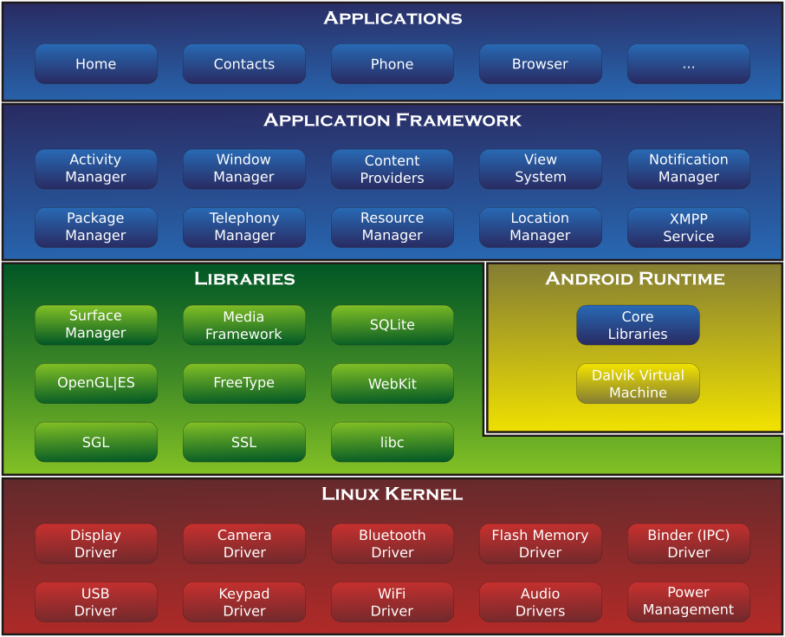
What is Android?
All of this is in an Android phone
Android Programs
Android App Programming
Interface
Android
“Engine”
Non-Android Features
Operating
System
(Operates the hardware)
Notes:
The Android system is a lot of software.
But don’t worry. Most of it, you don’t need to understand at all.
Some of it you need to understand a little.
And a little of it you need to understand pretty well.
Mostly you need to know about the Android API.
The OS manages the hardware resources among the applications.
The Libraries are other pieces of technology like Graphics , Database, Video processing, and Web access
that are not specific to Android but are used by Android.
The Android Runtime engine launches and services the apps, which run in a “virtual machine” called Dalvik.
The virtual machine helps make Android apps portable to many different devices.
The Applications that you (and others) write sit on top of the Application Framework, which is full of features that
you can call from your Java code. This is the Android Application Programming Interface (API).
That is a lot of software. It probably represents millions of lines of code.
But as I said, you don’t really need to understand it all.
Also, there are many online resources available to help you learn and understand Android.

Slide 11
Application Overview
Android ships with a set of core applications including an email client, SMS program, calendar, maps, browser, contacts, and others.
Developers are free to take advantage of the device hardware, access location information, run background services, set alarms, add notifications to the status bar, etc.
Developers have full access to the same framework APIs used by the core applications.

Slide 12
Android Resources
Android
API
Eclipse
IDE
Internet Search
Android
Developer
Site
Java
http://developer.android.com
http://eclipse.org
http://java. com
Notes:
These are the primary resources at your disposal.
There are tools to help you design your screens, write your code,
run your code, and fix your code.
And there are many sources of information online.
What is amazing about them is that they are all free.
You will be using Eclipse to write, build, run, and debug your Android programs.
You will be writing your programs in the Java programming language.
You will be making calls to the Android API from your programs.
developer.android.com is a great information resource for Android.
It has many tutorials, design guidelines and tips, API documentation, and reference information.
It is also where you go to download new versions of the Android SDK (Software Development Kit: API and tools and docs).
Go to eclipse.org to get information and downloads for Eclipse,
and java.com to get information and downloads for Java.
Finally, your best friend when you get stuck is your good old web browser and Google search (or your favorite search engine).

Slide 13
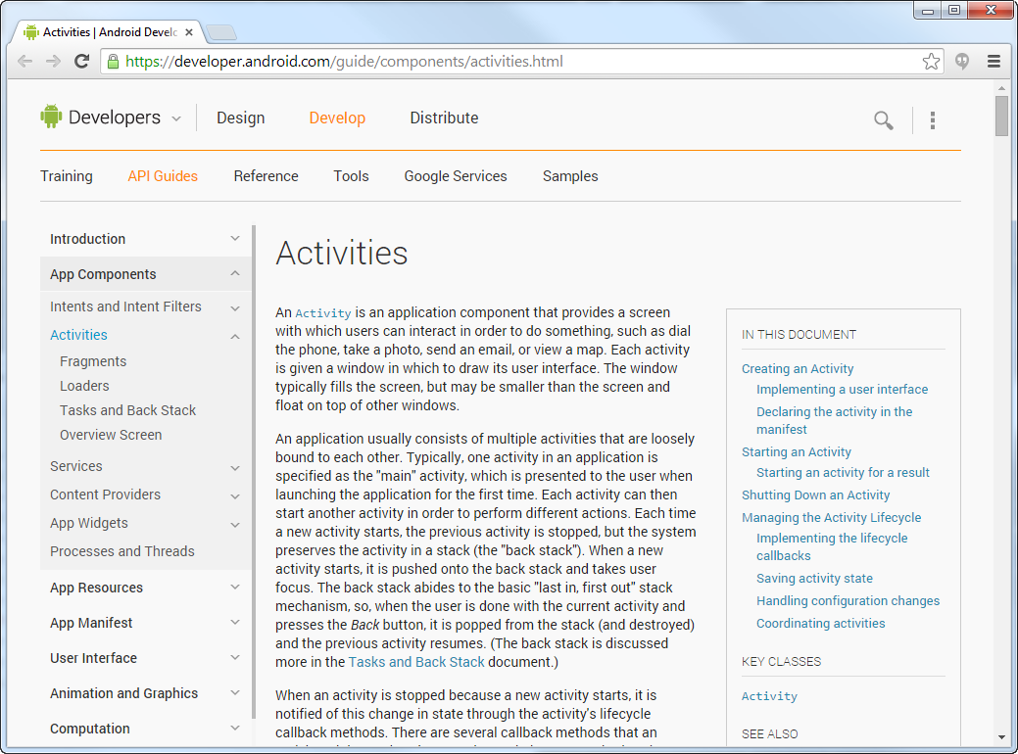
developer.android.com
Notes:
Here is a page from the developer.android.com website.
The site is full of high-quality, first-hand information. It is worth exploring.
And don’t worry if you don’t understand everything there. I don’t.
You should approach it like a game:
In the beginning you wander around and nothing is familiar.
You find things but you don’t know what they are or how they might be useful.
After a while you begin to see how things might fit together, and how
you can use some of the things you have discovered before.

Slide 14
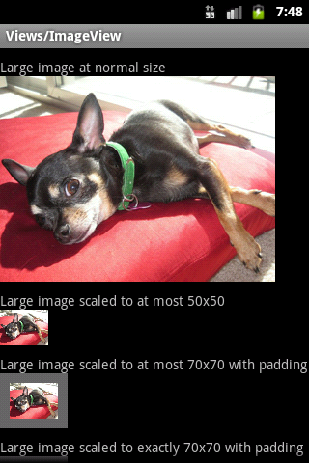
Key Terms and Concepts
Java and XML are the primary programming languages used in Android development
XML files are used to “layout” the screen
The blueprint for where items are on the screen
Java files are used to “control” the screen
Actions needed to interact with the screen
Needs to be told about its applicable XML file
XML file
Draw the screen
Put big dog picture at the top of the screen
Then put text below it
Then…etc…..
Java file
Control the screen interactions
When the user taps on the picture of the dog – open a full size image
Do something else…
aka an
“Activity”

Slide 15

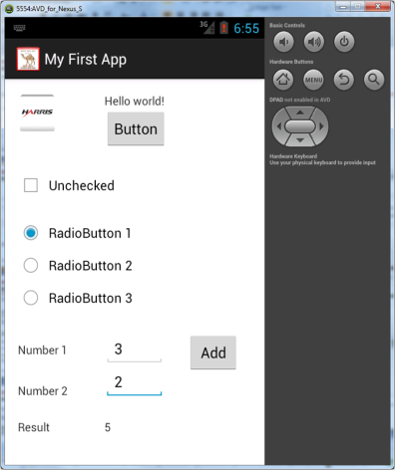



Eclipse IDE, ADT, Workflow
IDE: Interactive Development Environment ADT: Android Development Tools
Virtual Device
Eclipse IDE + ADT
in
builds your project with
runs on
You Write Java Code
generates
Android App
Real Device
Java Compiler
Notes:
This is the workflow you will use to build your Apps.
You will write Java code and use a graphical editor in Eclipse to define your App screens.
Eclipse will use Java to compile your code into an executable Android App.
Then Eclipse will download the app into a virtual device or a real device and run it.
Today we will go through the entire process except for running it on a real device.
We will only use the virtual device.
ADT knows about a lot of virtual devices.

Slide 16
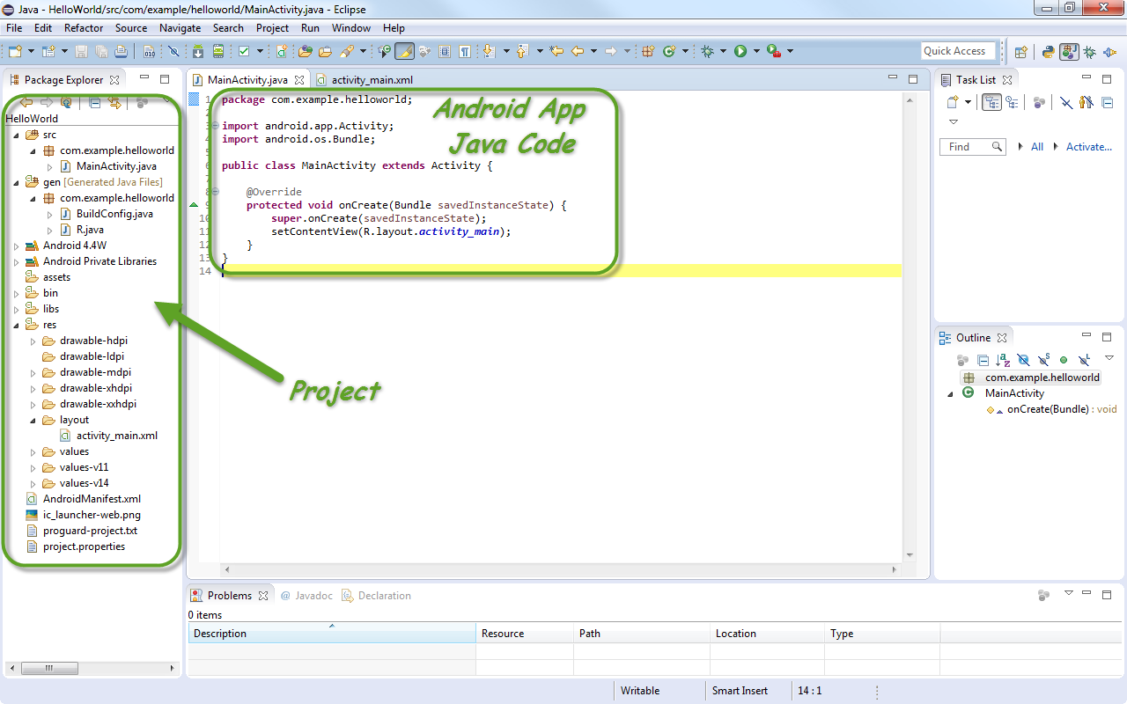
Eclipse Panels
Notes:
Eclipse puts up one big window with several panels in it.
The panels can be rearranged, but save that for another time. It will only slow us down here.
If you do accidentally close a panel, you can reset the window contents to the default layout
by going to the Window menu and selecting Reset Perspective.
The left panel is the Package Explorer, where you can find all the files in your project.
In the center area are different editors accessible by tabs.
You can double-click on a file in the Package Explorer to open it in a new editor tab.

Slide 17
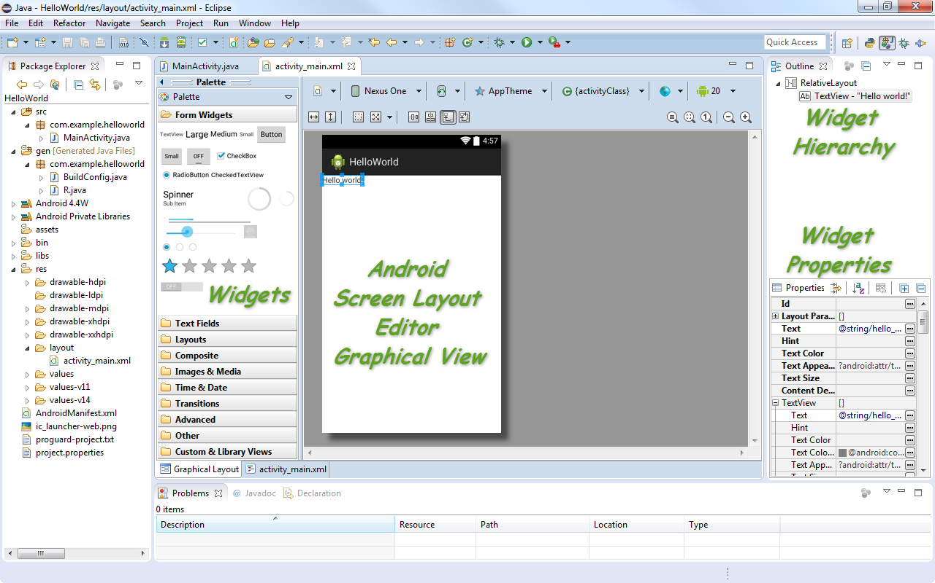
Android Visual Editor
Notes:
This is the visual editor that you use to lay out the screens of your App.
It is editing the file activity_main.xml.
If you look in the Package Explorer, you will see activity_main.xml in the layout subfolder which is in the res (resources) folder.
This editor provides you with many different ways – views – to look at your data.
In the center is the graphical view, showing what your screen will really look like when your app is running.
In the upper right panel is a hierarchical outline view of the relationships between widgets.
You can see that the RelativeLayout widget is a container that contains a TextView widget that says “Hello, world!”
In the lower right panel, you can see the many Properties of the widget that is currently selected.
If you look in the lower left of the screen editor panel you will see two tabs there.
Currently we are looking at the Graphical Layout view.
The other view is the XML view.
Do you know what XML is?

Slide 18
XML
XML: eXtensible Mark-up Language
<start>
</start>
Notes:
XML is a data notation.
It stands for: eXtensible Markup Language
You might be familiar with HTML: Hypertext Mark-up Language
It is a set of XML tags used for making web pages.
It is made up of elements inside of < >.
An element has a start: <start> [click]
And an end: </start> [click]
You can put other elements between the start and the end.
Say it was an XML description of a recipe….

Slide 19
XML Elements
XML: eXtensible Mark-up Language
<start>
<recipe>
<add>
</add>
<mix></mix>
</recipe>
</start>
Notes:
Inside the recipe are the steps. [click]
… which are also elements.
<add> and <mix> are contained within the <recipe> element.
Notice each of the child elements has a start and an end tag.
Elements can also have attributes….

Slide 20
XML Attributes
XML: eXtensible Mark-up Language
<recipe>
<add ingredient=”eggs” num=”2”>
</add>
<mix time=”30”></mix>
</recipe>
Notes:
Elements can also have attributes.
Attributes have an attribute name, like “ingredient” or “time”, an equal sign, and a value.
Elements can have zero or any number of attributes.
As you can see, the XML notation is very regular, because it is meant to be machine-readable.
It is also very simple because it is meant to be human-readable, too.
To make it a little more readable for humans, there is a shorthand notation for the matching open/close tags.
When there are no child elements between an open and a close, you can squish them together, and just close
The oepn element with a />….

Slide 21
XML Self-Close
XML: eXtensible Mark-up Language
<recipe>
<add ingredient=”eggs” num=”2”>
<add ingredient=”eggs” num=”2” />
</add>
<mix time=”30”></mix>
</recipe>
Notes:
Those opening and closing tags without any inner elements between them can become a clutter,
so there is a special self-closing XML notation: [click]
Just put a slash before the ending bracket on an element to say that it has no children.

Slide 22


XML Style
</geek>
Notes:
Once you become familiar with XML, you are allowed to wear a shirt like this. [click]

Slide 23
Android Visual Editor (again)
Notes:
So now back to Eclipse.
Remember the graphical layout editor. The two tabs on the bottom left.
One says “Graphical Layout”, which is what we are looking at.
The other says “activity_main.xml”, which is the name of the actual file we are editing.
We can switch to the XML view by clicking on the tab.

Slide 24
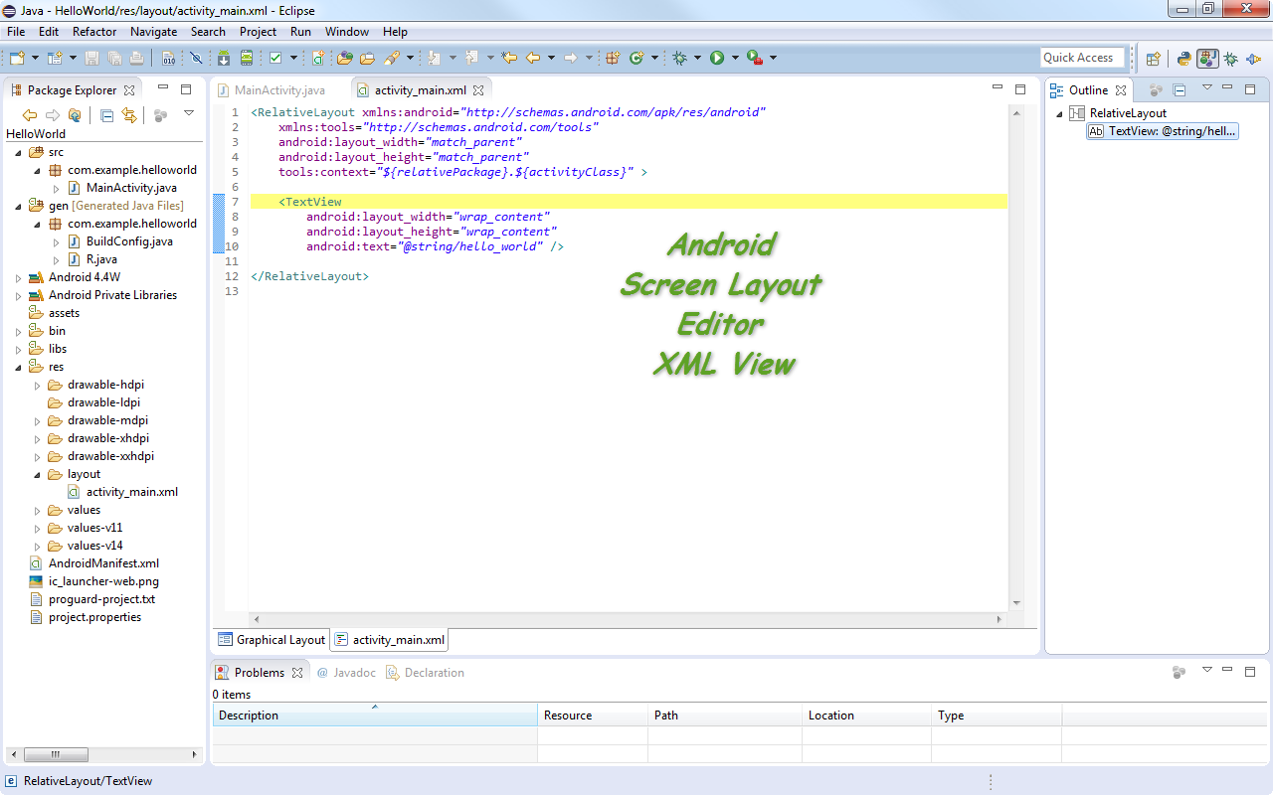
Android XML Editor
Notes:
This is an XML description of the graphical layout.
Now that you understand the structure of the XML (you are a true geek!),
You can see that there is an element called RelativeLayout, with a bunch of attribute names and values,
And it contains another element called TextView, which also has some attributes.
And TextView contains no other elements, so it can use the abbreviated closing notation.

Slide 25
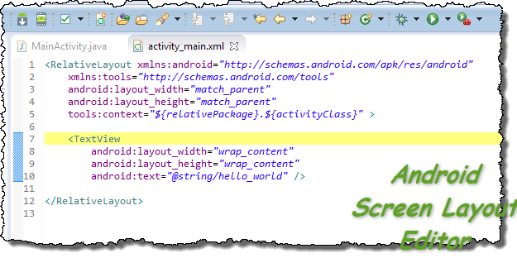
XML Screen Description
Notes:
Point out how the different views are tied together:
When something is selected in one view, it is selected in other views.

Slide 26
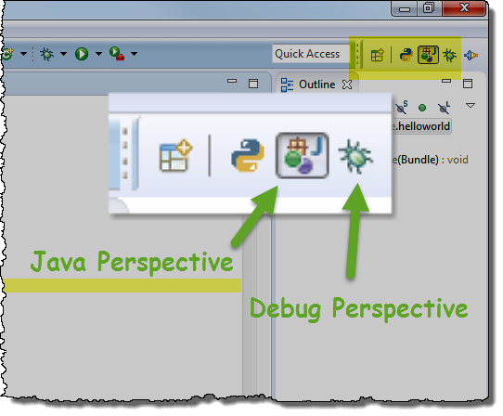
Eclipse Perspectives
Notes:
Perspectives change the arrangement of panels in the Eclipse window to suit a particular task.
By default, the interface shows the Java perspective.
Later, we will also use the Debug perspective.
The debugger lets you step through your code one instruction at a time.
Or you can set a breakpoint and have your code pause when it hits the breakpoint.
When your app is paused, you can check the value of variables in your program.

Slide 27
Key Terms and Concepts - Activities
Activities - Applications consist of multiple activities that are loosely bound to each other.
Each Activity can start another Activity in order to perform different actions
Each time a new Activity starts, the previous Activity is stopped, but the system preserves the Activity in a stack (the "back stack").
When a new Activity starts, it is pushed onto the back stack and takes user focus. The back stack abides to the basic "last in, first out" queue mechanism, so, when the user is done with the current Activity and presses the BACK key, it is popped from the stack (and destroyed) and the previous activity resumes.
Reference – Android Developers Dev Guide

Slide 28
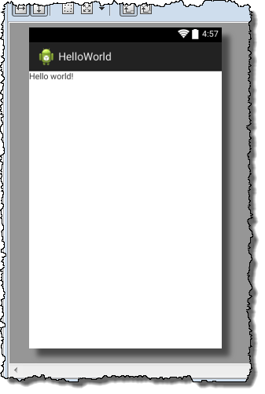
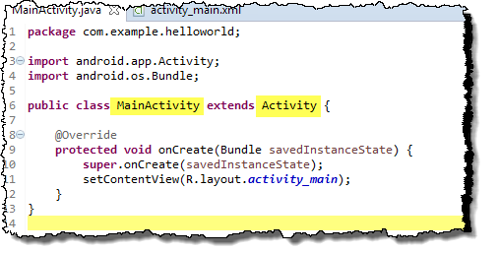
Activities
Activity ←→ A Screen
←→

Slide 29
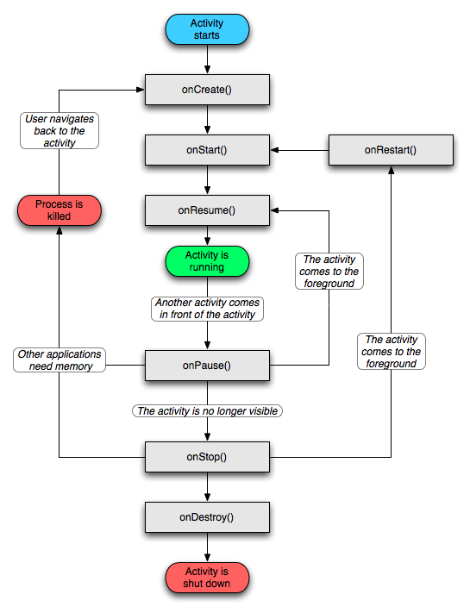
Key Terms and Concepts - Activities
The system notifies an Activity of state changes via a variety of callbacks
onCreate() - The system calls this when creating your activity
Define the layout for the Activity's user interface.
Initialize essential components of the Activity.

Slide 30
The Activity Life Cycle
Every Activity goes through different stages (states) of its life
Whenever it changes to a new state, an onEvent() method is called
The onEvent() methods are called “callbacks”
Callbacks are common in event-driven programming
Notes:
It will be very helpful to you later on, when you are writing your own Apps,
to be familiar with this diagram and to understand it.
This shows what happens to an Android Activity (screen, part of an App, maybe a whole App)
during its existence.

Slide 31
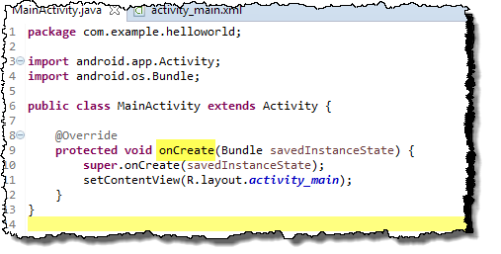
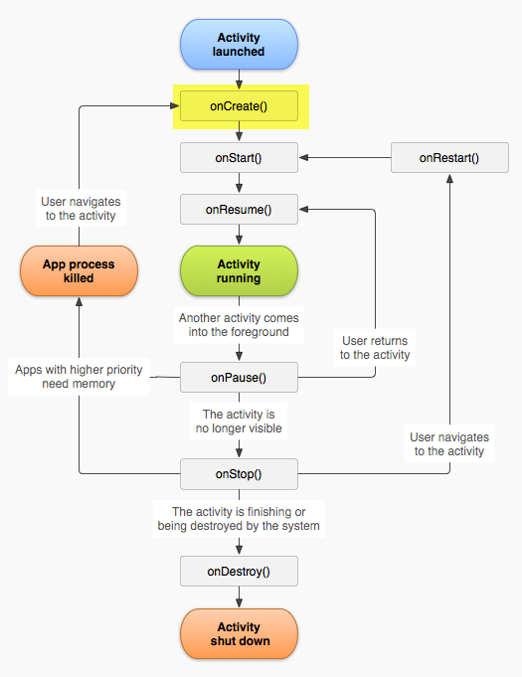
The onCreate() Method
2
1
4
3
The Activity is launched
The Activity’s onCreate() method is called
The Activity’s View is initialized
After onCreate(), the Activity enters the “Start” state
(What happens next?)
Notes:
Your App has to listen for these callbacks. It is not the boss. It does not control the hardware.
The Android OS is in charge of managing the hardware resources, and it is trying to share them
among many different Apps and background services.
Your App has to be ready and wait for the signal to do its thing.

Slide 32
Activities
onResume() – The Activity is coming to the foreground – it is about to be displayed.
Note – onCreate is only called when creating the Activity, if there are things that need to be handled every time the Activity is displayed.
Restart anything that was shut down in onPause.

Slide 33
Activities
onPause() – This is the first indication from the system that the user is leaving the Activity.
This will be called anytime the Activity will no longer have the foreground, such as if the user pressed the Home button.
Commit any changes that should be persisted beyond the current user session.
Stop any resource intensive work not needed now that the Activity is not displayed.

Slide 34
Android Development Tools
Using actual devices
Testing with a phone or tablet directly is supported
You may need to download device specific drivers
Settings on Android device need to be changed
Select Menu → Settings → Applications
Ensure that Unknown sources is checked
Select Menu->Settings->Applications->Development
Ensure that USB debugging is checked
Using simulated devices
Very useful for initial development and testing
We will create one as part of the first lab
It will take a long time to start up the first time, leave it open once it running. You do not need to reopen every time you recompile

Slide 35
Developing on Real Devices
Eclipse/ADT supports testing with a phone or tablet
Connect with USB
Settings on Android device need to be changed
Select Menu → Settings → Applications
Ensure that Unknown sources is checked
Select Menu → Settings → Applications → Development
Ensure that USB debugging is checked
You may need to download device-specific drivers

Slide 36
Developing on Virtual Devices
ADT simulates a phone on your computer
Very useful for initial development and testing
We will create one as part of the first lab
It will take a long time to start up the first time
Leave it open once it running
You do not need to reopen every time you recompile

Slide 37
Lab – Hello World!
It’s time to do our first lab!
When you complete this lab, you will have learned how to
Create a new project
Navigate within a project
Run the completed project on an Android Virtual Device (AVD)
Note – the Android development environment evolves rapidly
It is OK if some of the following screen shots do not exactly match what you see displayed
It is OK if the code in your lab project does not exactly match the example code

Slide 38
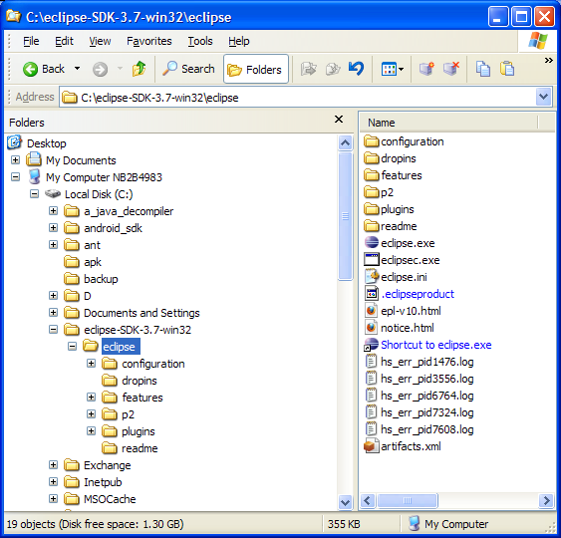
Lab – Hello World!
Eclipse is the Integrated Development Environment (IDE) we will use for Android programming
Open by double clicking on the eclipse.exe file
Yours may be in a slightly different location
Eclipse is free and a great IDE – but sometimes you get what you pay for – it can be buggy

Slide 39
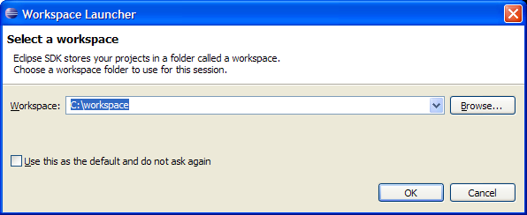
Lab – Hello World!
When Eclipse starts it will ask you for a workspace folder to store projects in
For this lab we will create ours on the C drive
For your own setup you can place it where ever you like, but Eclipse doesn’t like spaces in file paths
If you are using a USB drive, please select it here, instead of selecting the C: drive. Your workspace can be on a USB drive. Keep the path to your workspace simple.
Click OK.

Slide 40
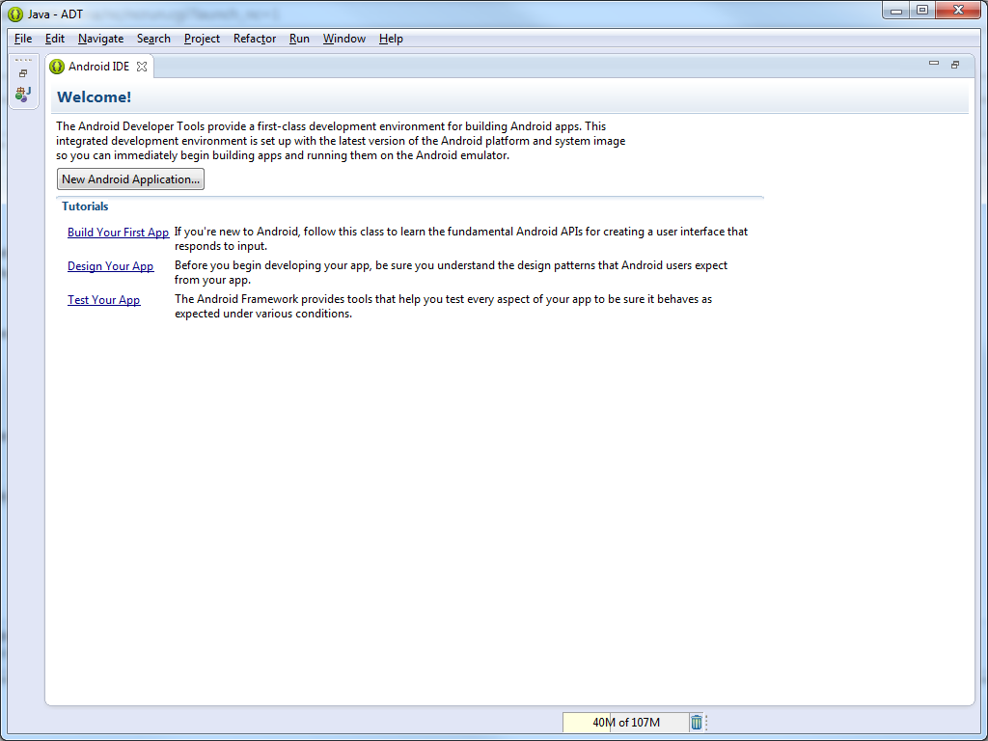
Lab – Hello World!
On first launch of Eclipse, you may see a welcome screen. Click the X on the Android IDE tab.

Slide 41
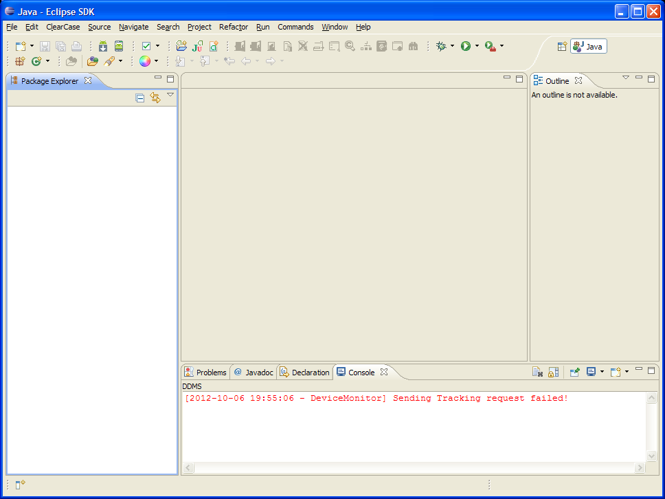
Lab – Hello World!
This area is where files will be loaded and we can edit them
This area will provide information regarding a variety of things, but we will mainly use it to see errors reported when we build projects
Package Explorer is where we will view our files once we make a project

Slide 42
Lab – Hello World!
Use the File menu to create new Projects and Files
Use the Play button to run your project after it compiles. If you have a phone or virtual device connected, this will install the app to the device and you can view it there.
Use the Project menu to clean and rebuild your Project. This will become your friend – Eclipse is free…
Use the Window menu to access the AVD manager to create an Android Virtual Device

Slide 43
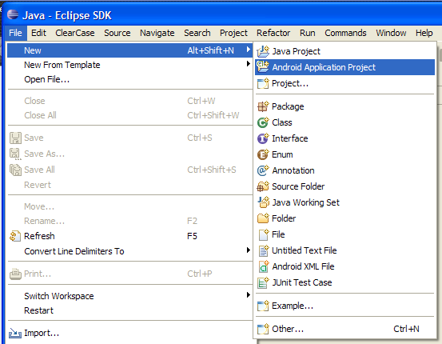
Lab – Hello World!
Time to make the HelloWorld app!
To create a new project, from the main menu select
File → New → Android Application Project

Slide 44
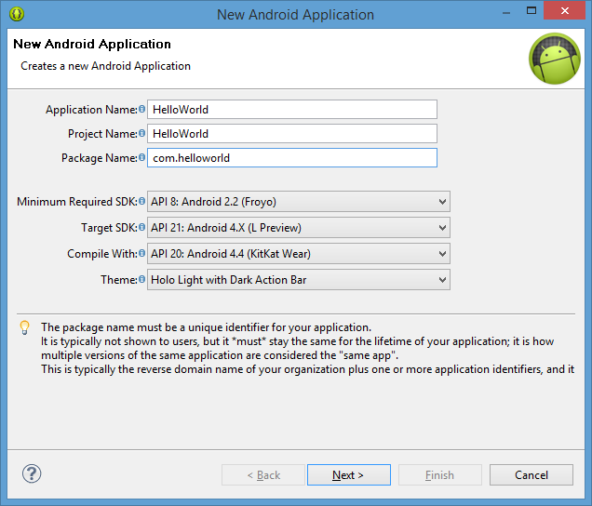
Lab – Hello World!
The New Android App Wizard starts
This will step us through everything we need to do to get our project created
If there are errors, it will mark things red and show a hint at the top of the screen
We will use mostly defaults

Slide 45
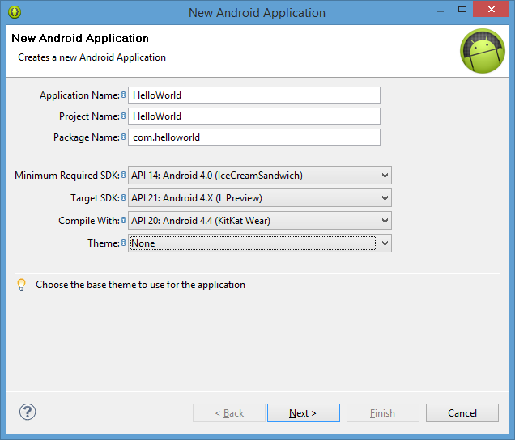
Lab – Hello World!
Enter a name for the project.
The wizard “helps” by filling in some of the rest. Remove “example” from the package name
Change the minimum SDK selections to be Android 4.0. If lower, then a second project will be created.
Change the Theme to None.
Leave the rest as-is.
Click the Next button.

Slide 46
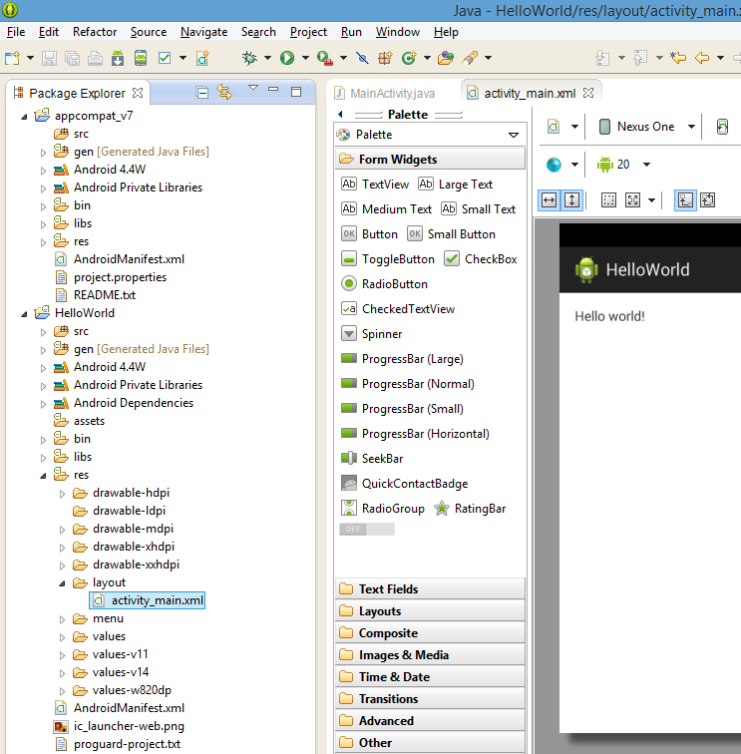
Don’t Pick Version 4.4W KitKat Wear
We recommended setting the minimum SDK as 14 (4.0) or above
If not you will have issues with libraries, linking, and the emulator
With version 4.4 an extra project may be created called appcompat_v7.
This provides action bar capability for android versions 13 (3.2) and below.
It may require some extra steps
A good YouTube video that explains it a bit is located here: https://www.youtube.com/watch?v=-Rcrpq11oww

Slide 47
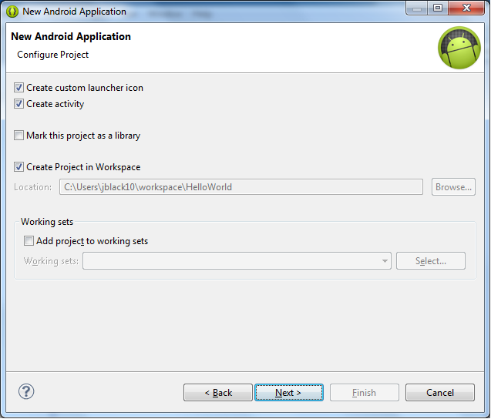
Lab – Hello World!
Leave everything as-is
Click the Next button

Slide 48
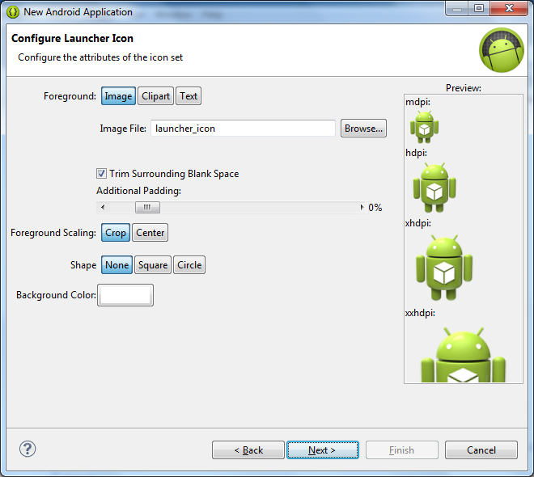
Lab – Hello World!
Leave everything as-is
Click the Next button

Slide 49
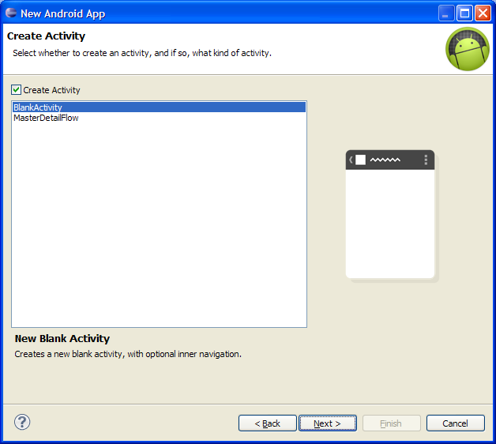
Lab – Hello World!
Leave everything as-is
Click the Next button

Slide 50
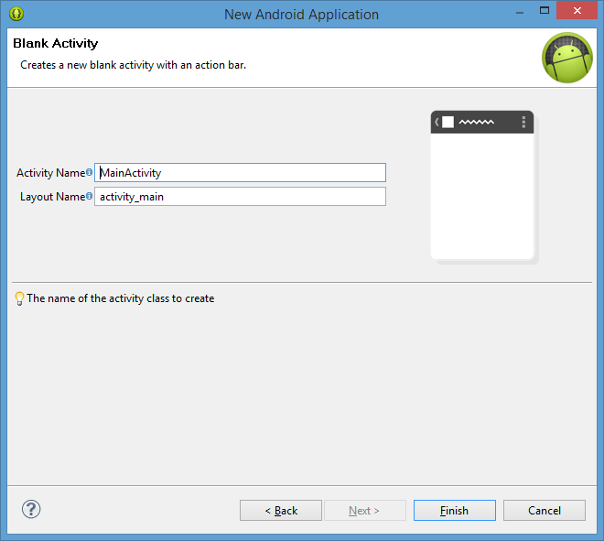
Lab – Hello World!
Leave everything as-is
Click the Finish button

Slide 51
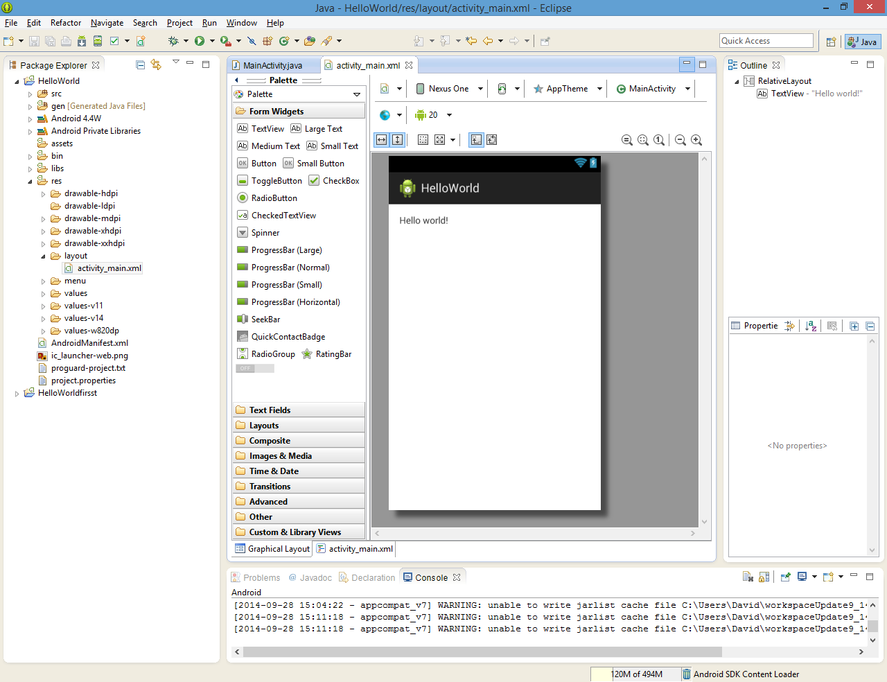
Lab – Hello World!
The new project has been created and has been added to the workspace. It is okay if your layout looks a little different.

Slide 52
Lab – Hello World!
Let’s look at the structure of a project
src/ - java source code
gen/
Android build tools use this for source code they generate
generated – do not touch
R.java will be in here and is used to reference items
assets/ - files you want packaged with your app
res/ - icons, layouts
AndroidManifest.xml
Key element
Lists all activities, services, permissions, API level
Used by Android Market to filter what apps are offered. So min Android 2.0 apps won’t be offered to someone running Android 1.5
default.properties – generated file – do not touch
build.xml – Ant script, generated. Not needed if using IDE
bin/ - compiled output
libs/ - use this folder to hold third party JARs
APK file – the zip archive that is essentially the android executable
Items in blue are where most of your changes will occur

Slide 53
Lab – Hello World!
The project is ready to be run for the first time but there isn’t anything to run it on yet – we need an Android Virtual Device (AVD)
AVD Manager
Is an Android Virtual Device (AVD), a.k.a Emulator, that models an actual device by defining hardware and software options to be emulated
Launches a window that looks like an android phone
Startup is slow, even on high-end computers
Can be configured to emulate most aspects of a real Android device such as SD Card, incoming calls, incoming SMS, etc
Useful for validating basic functionality for devices not available
You will most often just use the defaults values
Create as many AVDs as needed, based on the types of devices to be modeled

Slide 54
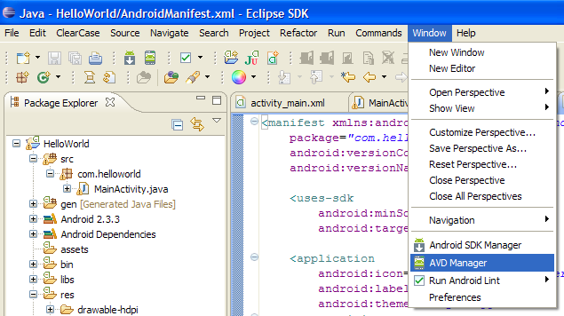
Lab – Hello World!
To access the AVD Manager select Window → AVD Manager
or
Window → Android Virtual Device Manager

Slide 55
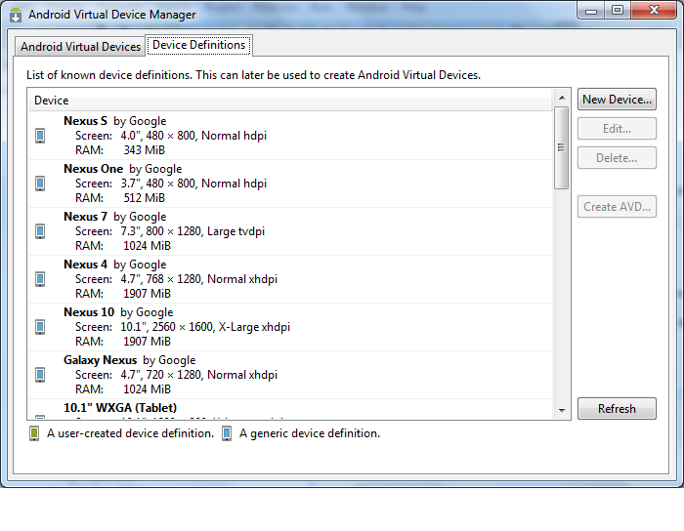
Lab – Hello World!
Select Device Definition
Select Nexus One by Google
Select the Create AVD button

Slide 56
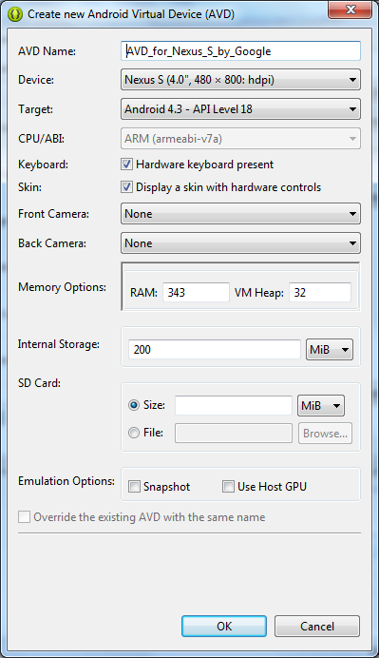
Lab – Hello World!
If your computer has trouble running out of memory, try decreasing the 343 to something like 256 or even 128.
Accept the defaults and select OK

Slide 57
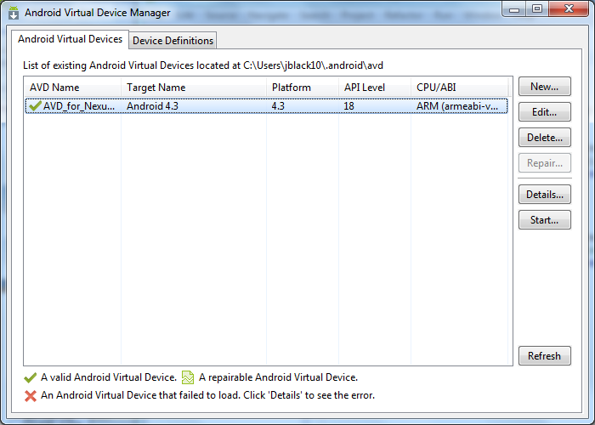
Lab – Hello World!
We now see the AVD we created listed
Click on it to select it
Press the Start button
The AVD will take a long time to be fully started
Leave it up and running during the labs. You will be unhappy if you shut it and have to wait for it to restart…

Slide 58
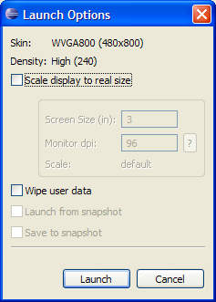
Lab – Hello World!
Leave as-is and press the launch button

Slide 59
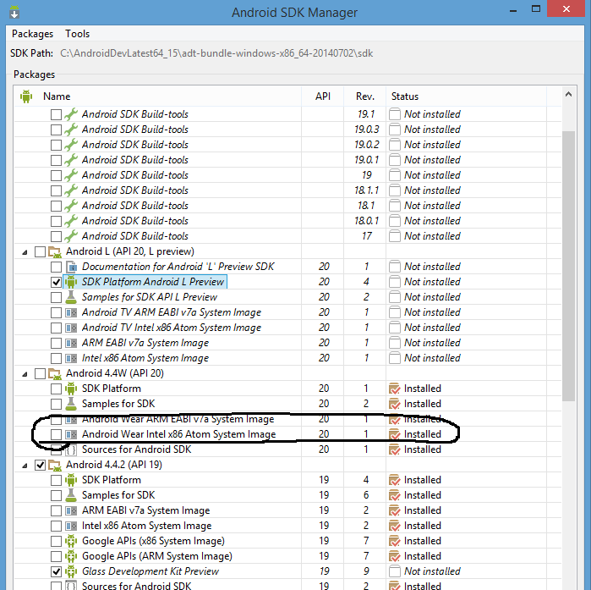
Custom Emulator
With some of the newer APIs we need to modify an existing emulator to suit our needs. We will
Clone an existing emulator and give it a new name
Associate it with the desired API
Make sure that the System Images are loaded
We do that via the SDK Manager that can be accessed through the Window Menu.
It may be preferable to install the API 19 components and base your emulator on that.

Slide 60
Custom Emulator
Select Device Definition
Select Nexus One by Google
Double Click to edit

Slide 61
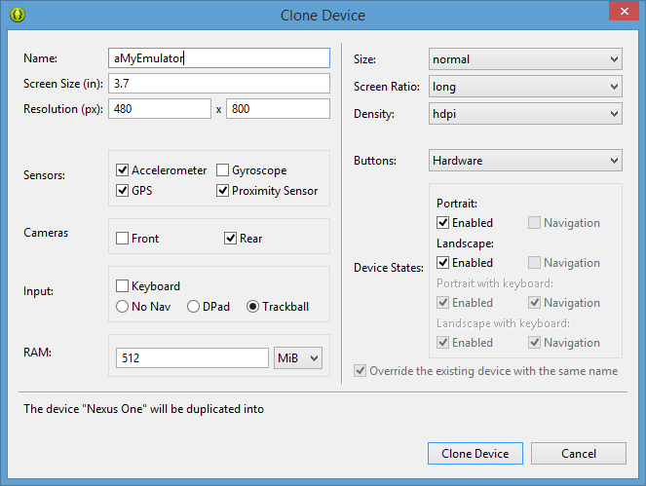
Custom Emulator
Rename from Nexus One to aMyEmulator (your choice)
2) Select Clone Device

Slide 62
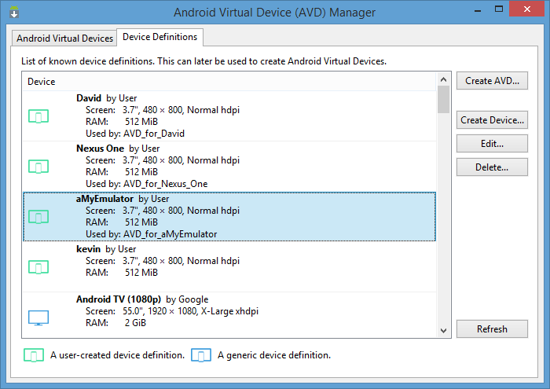
Custom Emulator
Confirm your emulator is in the list.
2) Select Create AVD

Slide 63
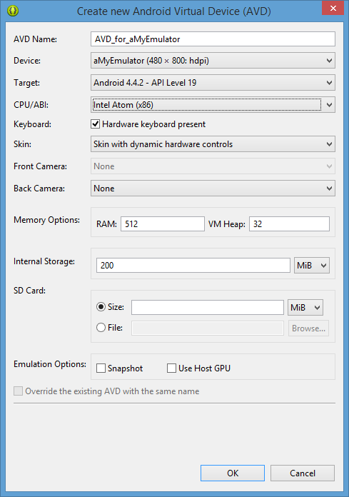
Custom Emulator
Select “Skin with dynamic hardware controls”
If your computer has trouble running out of memory, try decreasing the 343 to something like 256 or even 128.
Accept the defaults and select OK

Slide 64
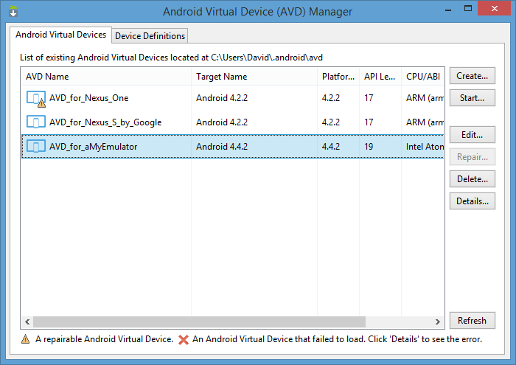
Lab – Hello World!
We now see the AVD we created listed
Select it and then press the Start button
The AVD will take a while to fully start
Leave it up and running during the labs, you do not need to keep restarting it

Slide 65
Custom Emulator
Leave as-is and press the launch button

Slide 66
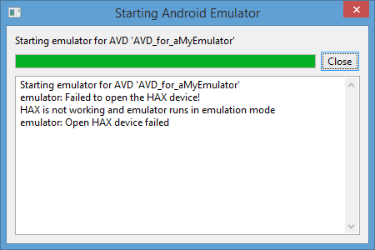
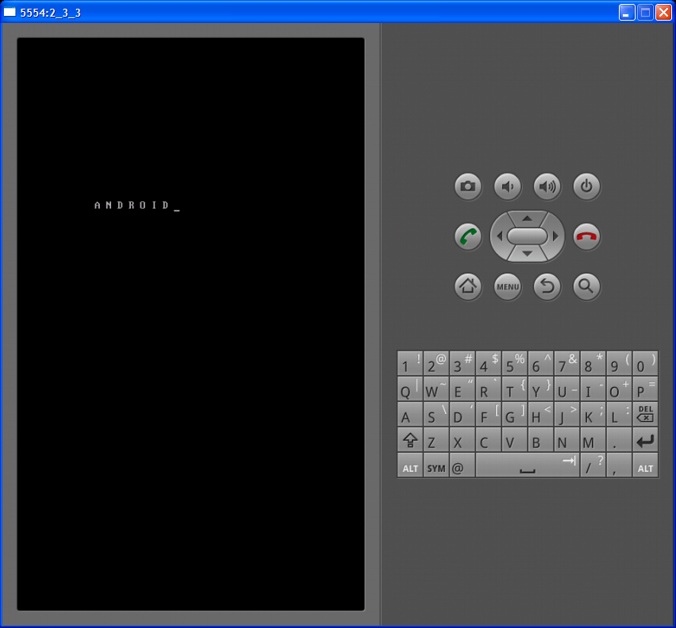
Lab – Hello World!
Note that your emulator may look different.
This is going to take a while…
Questions on what we’ve covered so far?

Slide 67
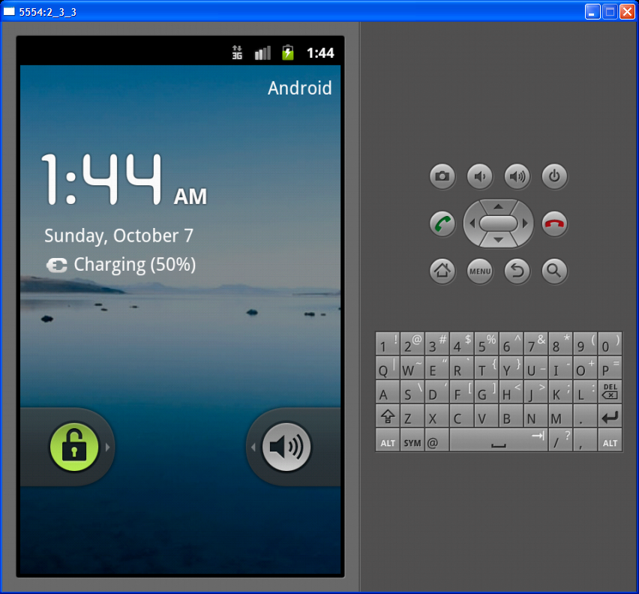
Creating an AVD
Once the AVD is up and running you may interact with it almost as if it were a real phone
Use your mouse to swipe open the phone

Slide 68
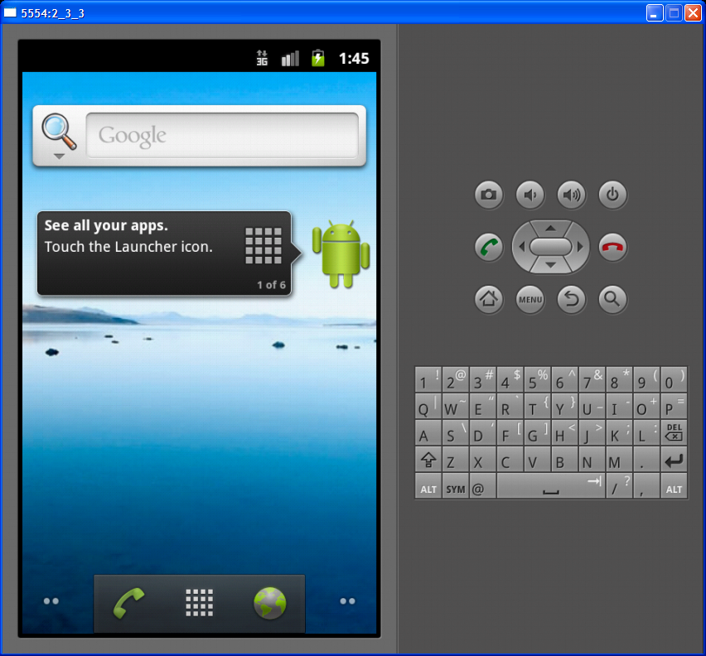
Lab – Hello World!
This is the Back button talked about earlier
The square of dots is used to access the apps installed on the virtual device
This is the Home button that takes the user to the main screen

Slide 69
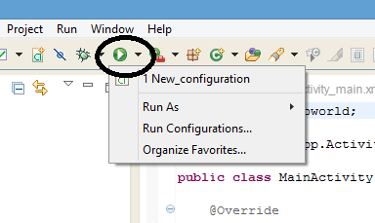
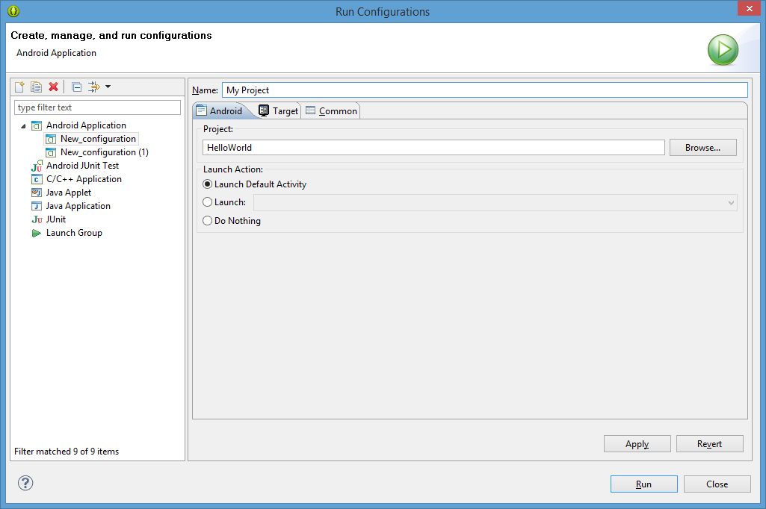
Create Run Configuration
Select Run Configurations
Select New Launch configuration icon
Give configuration a name
Browse to your project in your workspace
Select apply
Note: in target tab it is convenient to select the Always prompt to pick device option if you are running multiple emulators or a phone and emulator

Slide 70
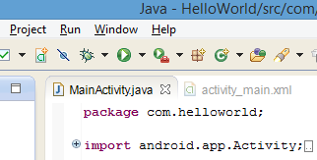
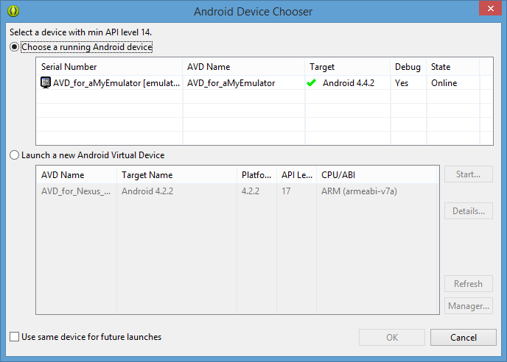
Lab – Hello World!
The project is ready to be run without any code changes.
Click on the Play button
Select your emulator in the ADC dialog
Click the OK button

Slide 71
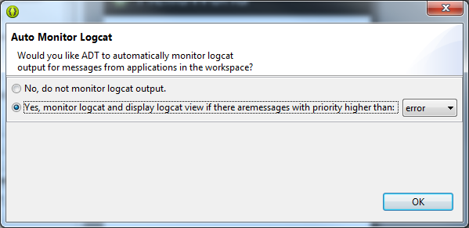
Lab – Hello World!
If asked if you want ADT to automatically monitor logcat, click OK.

Slide 72

Lab – Hello World!
Some status about the install to the device can be seen in the Console view

Slide 73

Lab – Hello World!
The app will be running and will display the values you defined earlier.
Congratulations!

Slide 74
Lab – Hello World!
Now, let’s make a change to the project and see what happens!

Slide 75

Lab – Hello World!
You can minimize windows in Eclipse to create more space
Minimize the Outline area at the right side
Minimize the bottom area with the Console in it

Slide 76

Lab – Hello World!
Now we can see the editor window better and we can zoom in on the layout editor being displayed.
Note the two tabs displayed – Graphical Layout and activity_main.xml.
For many xml files – like this Layout file, there will be more than one way to view and edit the file.
Click on the activity_main.xml tab so we can look at the file contents.

Slide 77

Lab – Hello World
XML code is just a series of object tags (RelativeLayout, TextView, Button, EditText, etc.) that are assigned properties.
They must have a start and end tag, or a shortcut end tag “ />” if they don’t contain other objects.
We won’t go into all the properties as part of this lab but it is important to remember we must assign a unique ID to the objects we add here that we want the Java code to interact with.

Slide 78

Lab – Hello World!
1. In the package explorer, expand the res/values folder
2. Double-click the strings.xml to open it in the editor
3. Use the Resources tab to modify the strings associated with your application

Slide 80

Lab – Hello World!
Let’s make a few changes:
Change app_name to “My First App”
Save the file, then click the run button again.

Slide 81

Lab – Hello World!
Application updates
with the string
changes.

Slide 82

Lab – Hello World!
Expand the src folder
Expand the com.helloworld package
Double-click MainActivity.java to open it in the editor

Slide 83
Lab – Hello World!
Step back a minute – recall from earlier
Graphical tools can be used to modify your layout
These tools update your XML files that are used to “layout” the screen
The blueprint for where items are on the screen
Java files are used to “control” the screen
Actions needed to interact with the screen
Needs to be told about it’s applicable XML file
aka an
“Activity”
XML file
Draw the screen
Put big dog picture at the top of the screen
Then put text below it
Then…etc…..
Java file
Control the screen interactions
When the user taps on the picture of the dog – open a full size image
Do something else…

Slide 84

Lab – Hello World!
MainActivity.java defines a class (named MainActivity) that will control the layout file
Creating that connection is done by “setContentView(R.layout.layoutFileName)” in our case activity_main

Slide 85

Lab – Hello World!
Open the AndroidManifest file by double-clicking it
This file has even more tabs – select the AndroidManifest.xml tab

Slide 86

Lab – Hello World!
This is the file that defines our app for the Android OS
Note the reference to the string file again for the app name
Note the use of start and end tags for everything defined

Slide 87
Locking Screen Orientation
Double click on AndroidManifest.xml
Select the MainActivity in the bottom left of the Application tab
In bottom right slide down to the “Screen Orientation” option.
Select portrait. This will lock the application to only portrait. Save Project. (File -> save)
Run in AVD and use 9 of keypad or CTRL F12 to rotate the AVD
Run before and after you update the code to emulator.
Notice that it doesn’t rotate in the screen now when you rotate the emulator (phone)

Slide 88

Locking Screen Orientation

Slide 89
Lab – Hello World!
AndroidManifest.xml
Every application must have an AndroidManifest.xml file in its root directory. The manifest presents information about the application to the Android system, information the system must have before it can run any of the application's code
uses-permission element – indicates what permissions your app needs
permissions elements – declares the permissions that Activities and Services require other apps to have in order to interact with your app
uses-library elements – attach to optional Android components
uses-sdk element
indicate the version of Android SDK the app was built for
Set minSdkVersion for Android Market
application element – define your app
activity elements
android.name – class implementing the activity
android.label – display name for the activity
intent-filter – under what conditions the activity will be displayed
ALL Activities used by the project MUST be declared in the Manifest

Slide 90

Great Resources
Use the Android Developers site
Use GOOGLE.
You can find pretty much everything you would need

Slide 91
Lab – Hello World! – Complete
The student should now be able to:
Create a new project
Navigating within a project
Run the completed project on an AVD

